Slide 1
Building Humanitarian Severity Index
Data Analysis Workshop

Slide 2
Building Severity Index
Objective of the session:
Building such index, also called composite indicator, is among the regular and expected task of any humanitarian data analyst.
Objective is simplify information into a simple indicator that can reduce information overflow.
Informs the sectoral and inter-sectoral discussions in order the facilitate analyis of needs between sectors.
A Severity index allows for comparability between different locations and over time.
It is a strong tool to support advocacy at different levels & phases and a requirement from interagency humanitarian needs overview (HNO) process.

Slide 3
Data set used for the analysis
comes from Key Informant Interviews affected by Hurricane Dorian, Bahamas - data available through HDX here.
Data were collected at the beginning of November 2019 by IOM/DTM in the Bahamas. See initial report
covers Abaco Island which has been severely hit by Hurricane Dorian on 1-3 September 2019.
Analysis can be reproduced on the next release of DTM to identify Severity Evolution over time.

Slide 4
Methodology: What is badly defined is likely to be badly measured.

Slide 5
Steps
When developing severity index, each steps comes with methodological questions:
How to select and organize indicators? (a consistent Framework)
How to calculate and reshape them? (polarity & normalization)
How to assemble them together? (aggregation and weighting).
What formula to retain? (comparison & sensitivity).

Slide 6
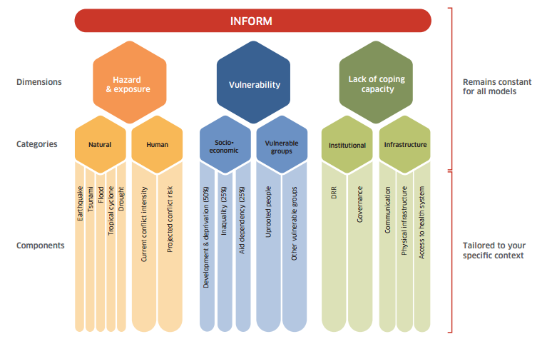
Severity Theoretical Framework
Composite indicators are generally used to summarize a number of underlying individual indicators or variables. There are basically three levels of indicator groupings:
Individual indicator sets represent a menu of separate indicators or statistics.
Thematic indicators are individual indicators which are grouped together around a specific area or theme.
Composite indicators are formed when thematic indicators are compiled into a synthetic index and presented as a single composite measure.
Example: INFORM Global Risk Index (GRI) Framework

Slide 7
Sub-Indicator Polarity
The polarity of a sub-indicator is the sign of the relationship between the indicator and the phenomenon to be measured (for instance, in a well-being index, “GDP per capita” has ‘positive’ polarity and “Unemployment rate” has ‘negative’ polarity), which means here:
Negative (the higher score, the more severe) or
Positive (the higher score, the less severe)

Slide 8
Data Normalization
Data Normalization allows for adjustments of distribution (similar range of variation) and scale (common scale) of sub-indicators that may reflect different units of measurement and different ranges of variation. Different possible options:
A z-score approach: Imposes a distribution with mean zero and variance 1. Standardized scores which are below average will become negative, implying that further geometric aggregation will be prevented.
A min-max approach: Same range of variation [0,1]) but not same variance. This method is very sensitive to extreme values/outliers
A ranking method: Scores are replaced by ranks – e.g. the highest score receives the first ranking position (rank 1).

Slide 9
Calculating sub-indicators values
Different calculations were used depending on the type of questions used in the severity framework:
For binary questions, negative questions receive a score of 1 when answered positively, and 0 when “no”
Some select_one response choices is ordinal data with an imputed ordered response, where the max score is given either to the best or worst possible choice.
Some select_multiple questions might have many dummy variables corresponded to the question and the sum of these scores represented the highest score possible. Other select_multiple response choices are discrete choice data with nominal responses; each answer in the select_multiple are weighted according their severity.

Slide 10
Correlation & Consistency between Indicators
Checking correlation between indicators allows to ensure that they actually measure a meaningful composite (if not enough correlated, they are not related, if too correlated, sub-indicators are redundant). This is an essential step to eliminate indicators from the theoretical framework.
Cronbach’s alpha, (or coefficient alpha), also measures reliability / consistency (i.e. how well a test measures what it should: measure of the stability of test scores). As a rule of thumbs, a score of more than 0.7 indicates an acceptable level of consistency:
A high level for alpha may mean that all indicators are highly correlated (meaning we have redundant indicators representing the same thing…).
A low value for alpha may mean that there are not enough indicators or that the indicators are poorly interrelated.

Slide 11
Aggregation & Weighting
For weighting, the main issue to address is related to the concept of compensability. Namely the question is to know to what extent can we accept that the high score of an indicator go to compensate the low score of another indicator?
This problem of compensability is intertwined with the issue of attribution of weights for each sub-indicator in order to calculate the final aggregation.
Simply using “equal weight” (all indicators account for the same in the final index) and “arithmetic aggregation” (all indicators are substituable) is unlikely to depict the complex issue of Humanitarian Severity and is likely to comes with the risk of misrepresenting the reality.

Slide 12
Benefice of the Doubt
Benefit of the Doubt approach (BoD), application of Data Envelopment Analysis (DEA), ensures that weights are endogenously determined by the observed performances. Benchmark is not based on theoretical bounds, but it’s a linear combination of the observed best performances.
Directional Benefit of the Doubt (D-BoD) model enhances non-compensatory property by introducing directional penalties in a standard BoD model in order to consider the preference structure among simple indicators.
Robust Benefit of the Doubt approach (RBoD) is an extension of BoD based on the concept of the expected minimum input function.
Benefit of the Doubt approach (BoD) index with constraints on weights allows for constraints (so that there is none not valued) and with a penalty.

Slide 13
Other algorithms
Factor analysis groups together simple indicators to estimate a composite indicator that captures as much as possible of the information common to individual indicators.
Mean-Min Function is an intermediate case between arithmetic mean, according to which no unbalance is penalized, and min function, according to which the penalization is maximum.
Geometric aggregation uses the geometric mean to aggregate the single indicators and therefore allows to bypass the full compensability hypothesis using geometric mean.
Mazziotta-Pareto Index transforms a set of individual indicators in standardized variables and summarizes them using an arithmetic mean adjusted by a “penalty” coefficient related to the variability of each unit.
Wroclaw taxonomy method is based on the distance from a theoretical unit characterized by the best performance for all indicators considered.

Slide 14
Comparing Output
Using each of the algorithm explained above, locations will be ranked differently.
Sensitivity Analysis
Looking at results, we can identify and retain the most stable aggregation method.

Slide 15
Thematic Dimension: Protection

Slide 16
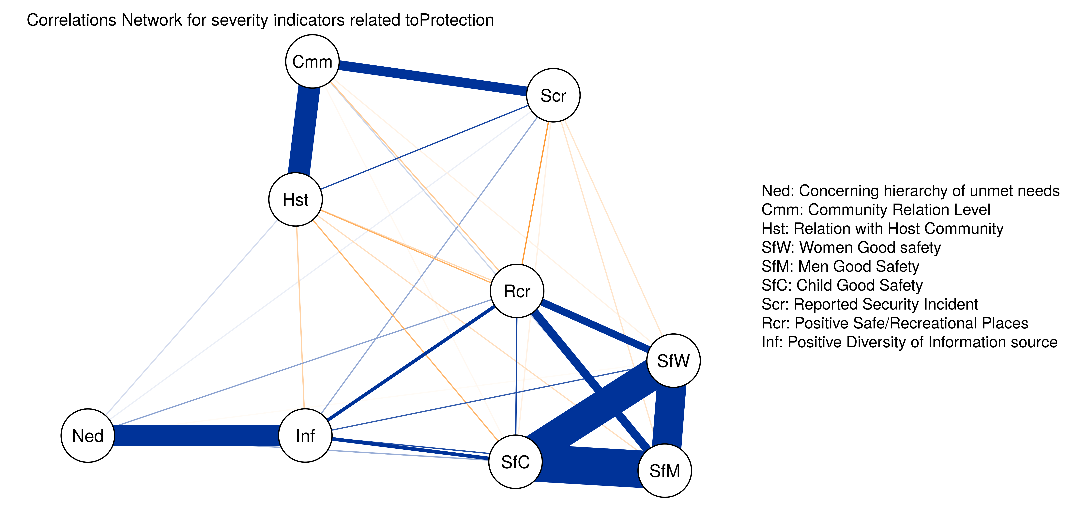
Correlations Network : (Alpha consistency is 0.77)

Slide 17
Selected Indicators
qlabel | Calculation | Polarity
Concerning hierarchy of unmet needs | scored | Negative (the higher score, the more severe)
Community Relation Level | scored | Negative (the higher score, the more severe)
Relation with Host Community | scored | Negative (the higher score, the more severe)
Women Good safety | scored | Positive (the higher score, the less severe)
Men Good Safety | scored | Positive (the higher score, the less severe)
Child Good Safety | scored | Positive (the higher score, the less severe)
Reported Security Incident | binary | Negative (the higher score, the more severe)
Positive Safe/Recreational Places | binary | Positive (the higher score, the less severe)
Positive Diversity of Information source | scored | Positive (the higher score, the less severe)

Slide 18
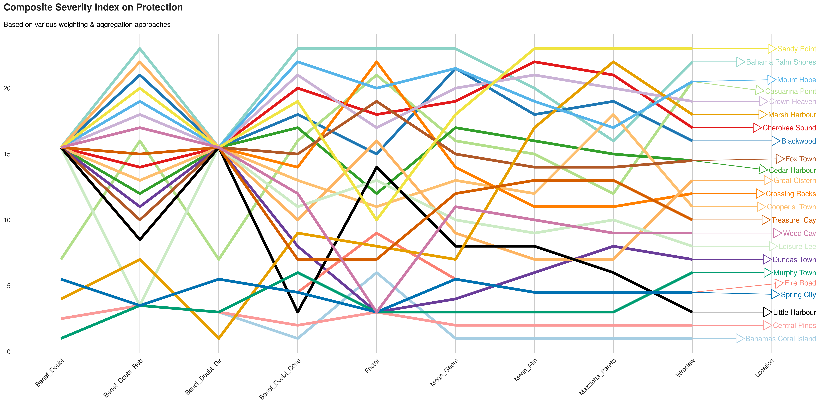
Comparing ranks per method

Slide 19
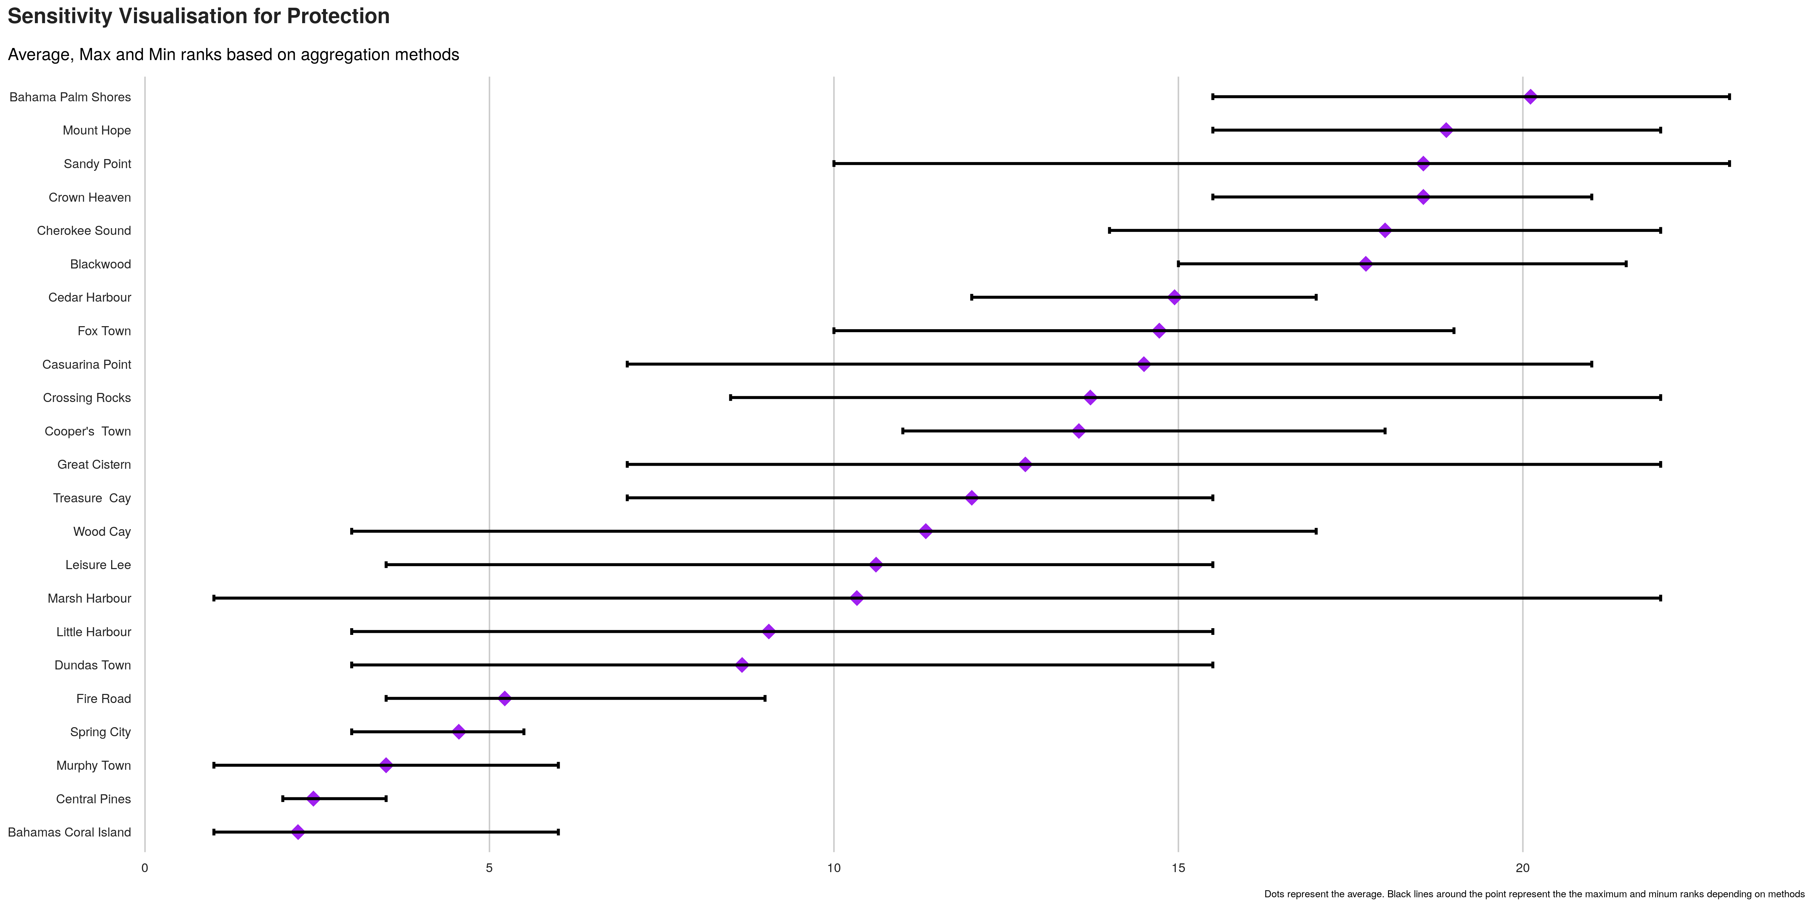
Index sensitivity to method

Slide 20
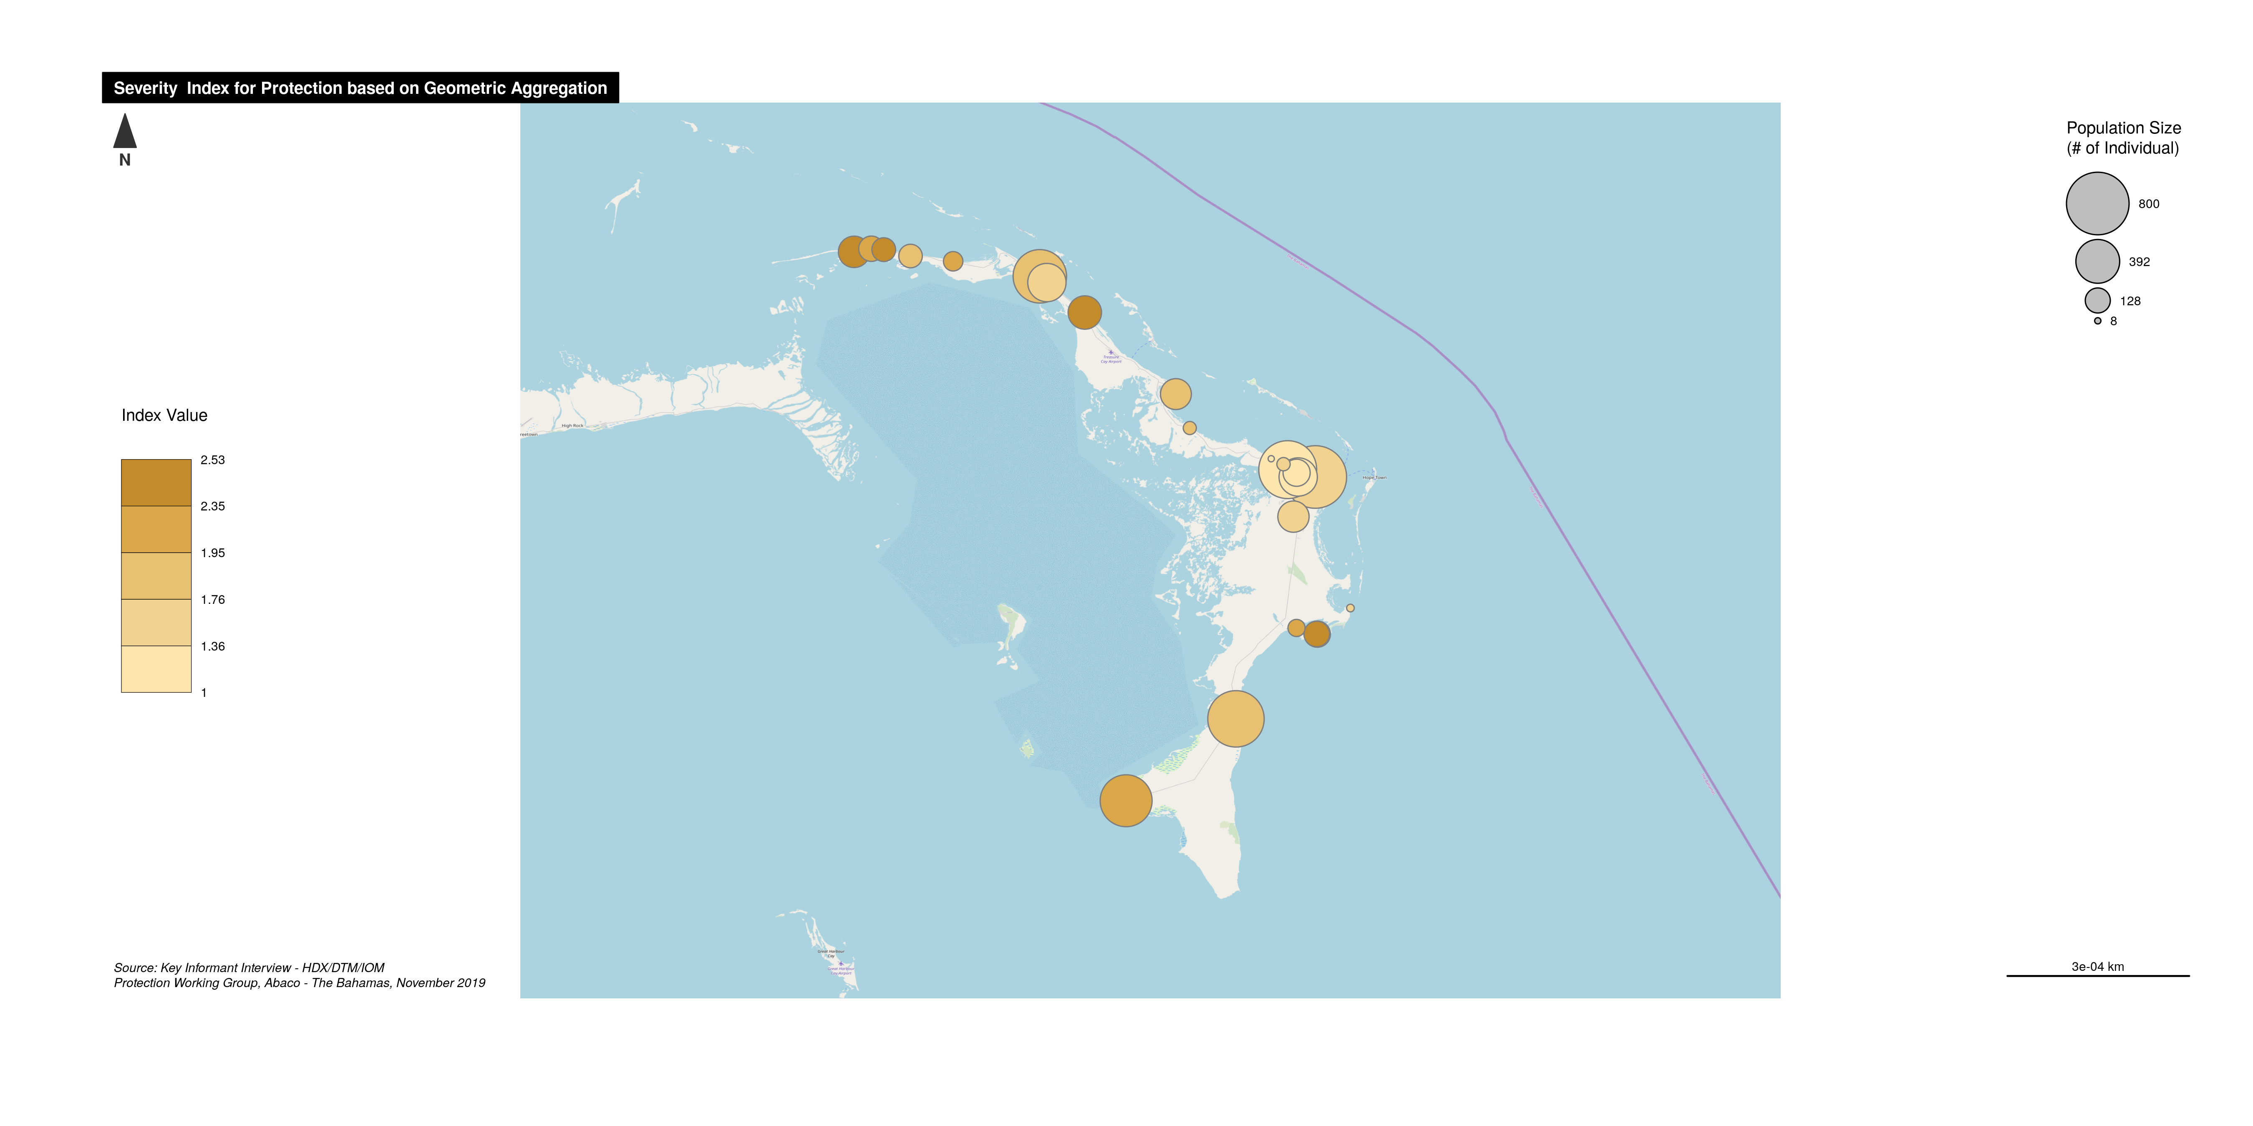
Severity Index Map

Slide 21
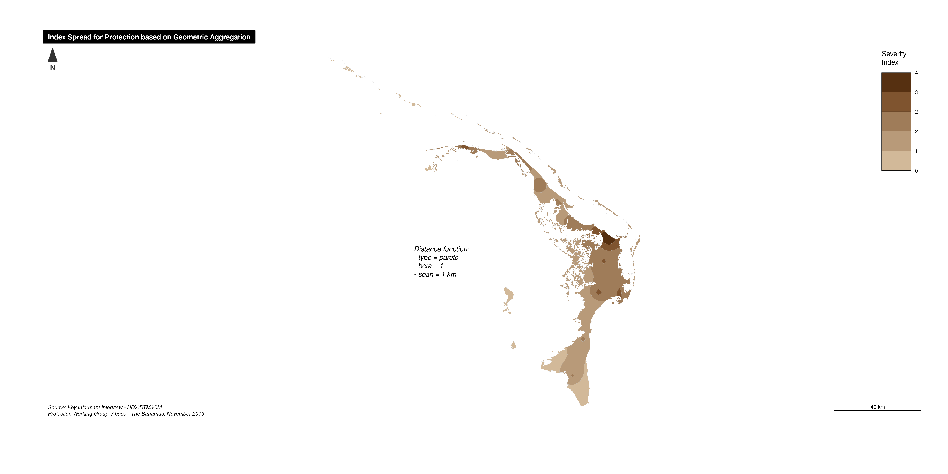
Smoothed Severity map

Slide 22
Thematic Dimension: Basic Needs

Slide 23
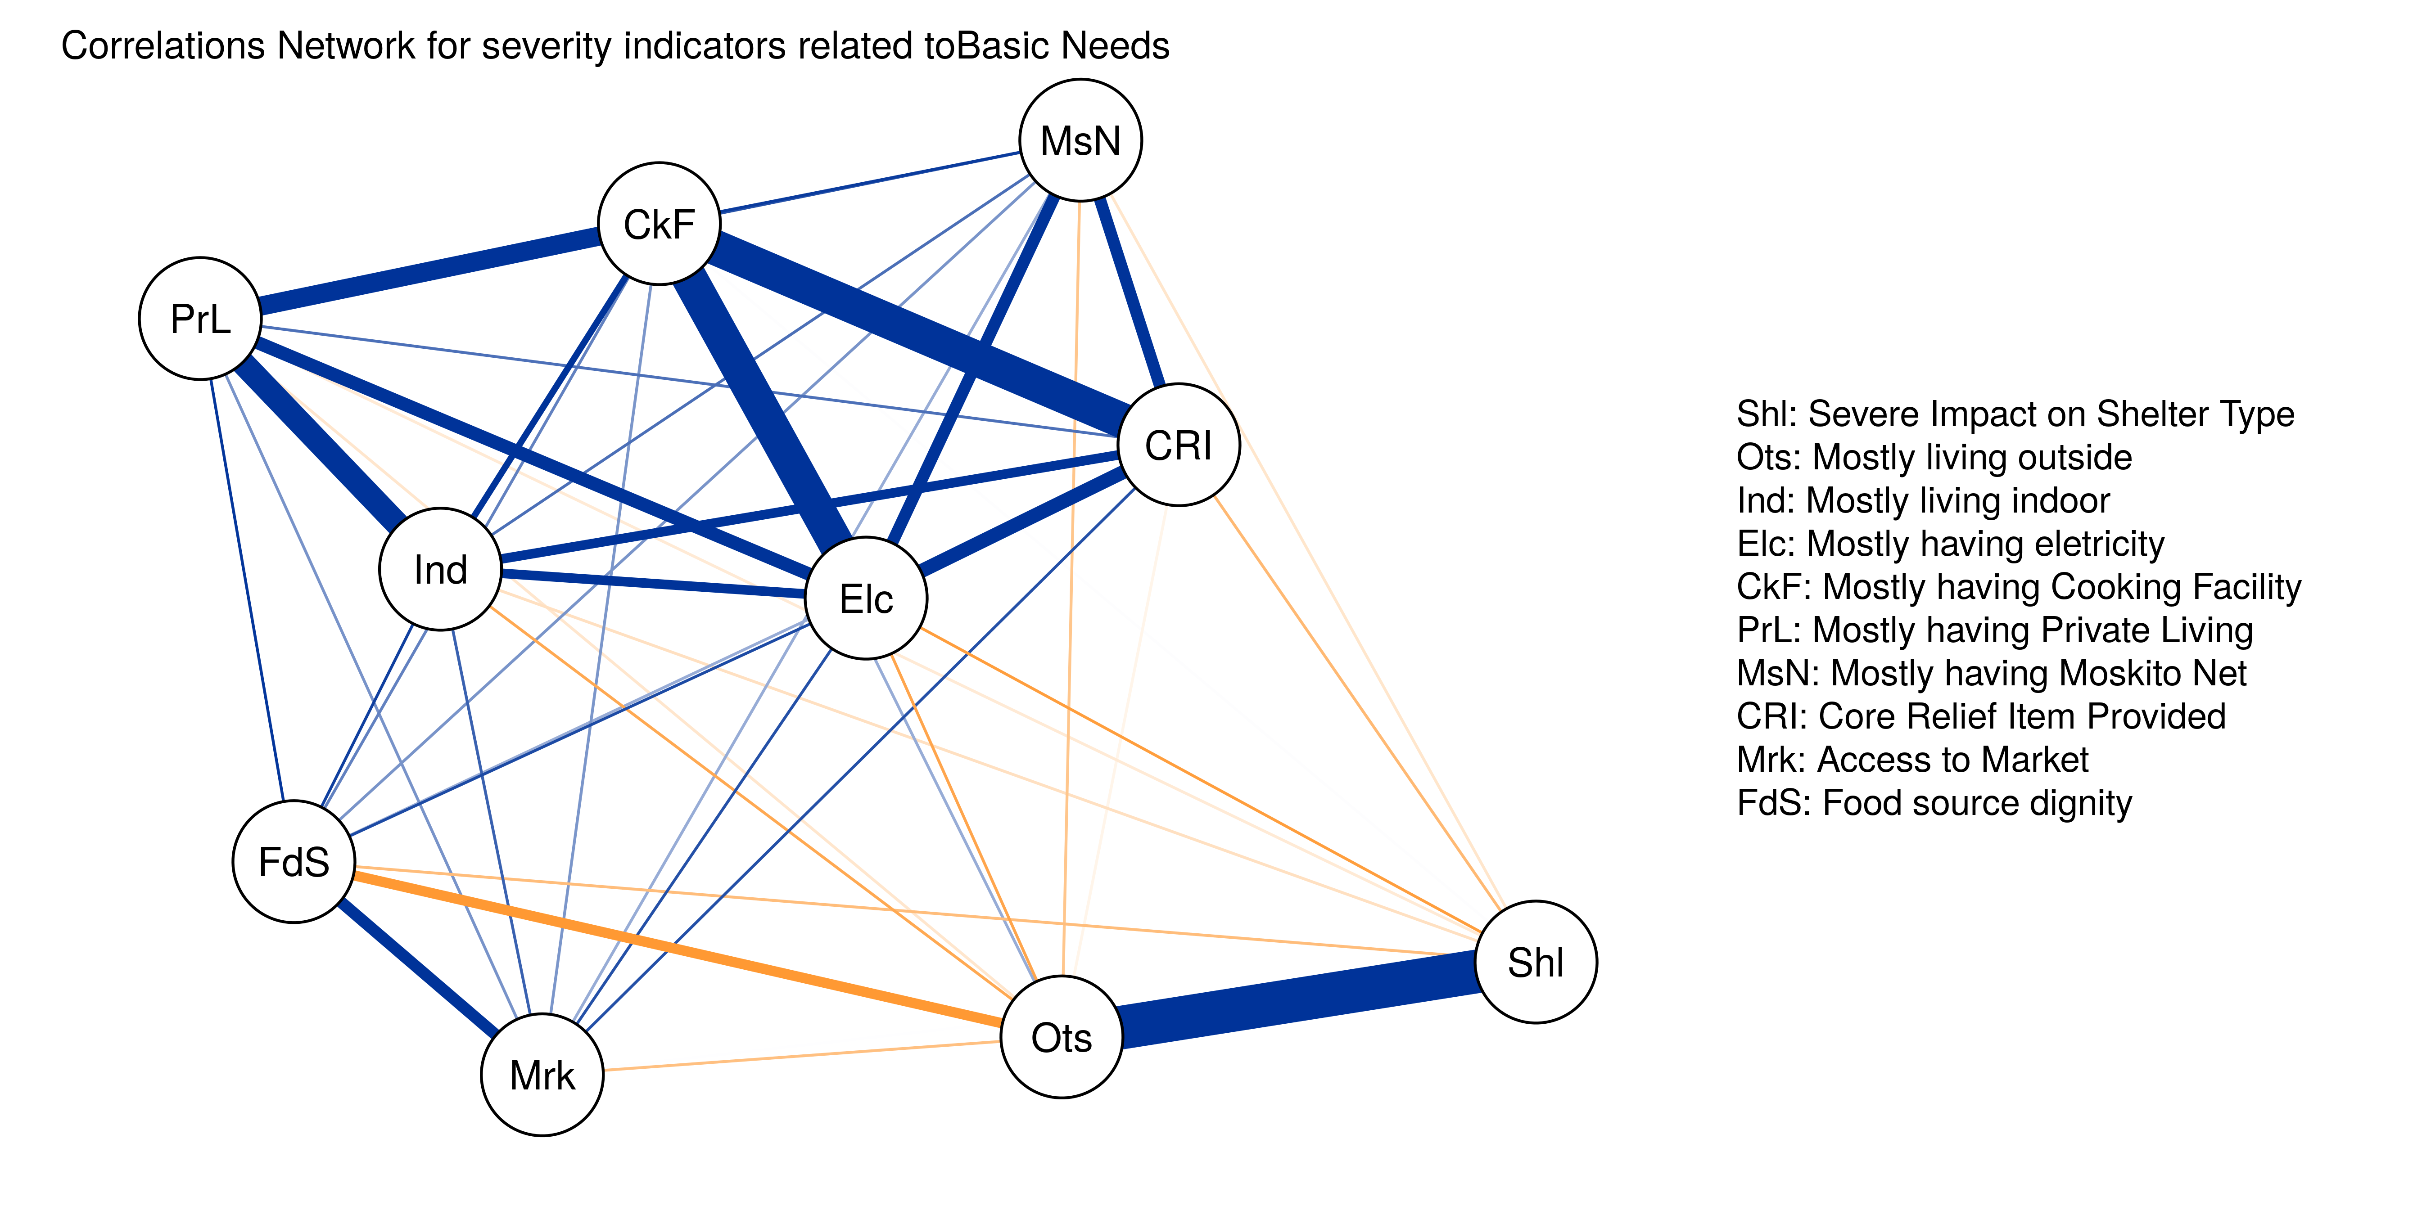
Correlations Network : (Alpha consistency is 0.82)

Slide 24
Selected Indicators
qlabel | Calculation | Polarity
Severe Impact on Shelter Type | scored | Negative (the higher score, the more severe)
Mostly living outside | binary | Negative (the higher score, the more severe)
Mostly living indoor | binary | Negative (the higher score, the more severe)
Mostly having eletricity | binary | Positive (the higher score, the less severe)
Mostly having Cooking Facility | binary | Positive (the higher score, the less severe)
Mostly having Private Living | binary | Positive (the higher score, the less severe)
Mostly having Moskito Net | binary | Positive (the higher score, the less severe)
Core Relief Item Provided | binary | Positive (the higher score, the less severe)
Access to Market | binary | Positive (the higher score, the less severe)
Food source dignity | scored | Positive (the higher score, the less severe)

Slide 25
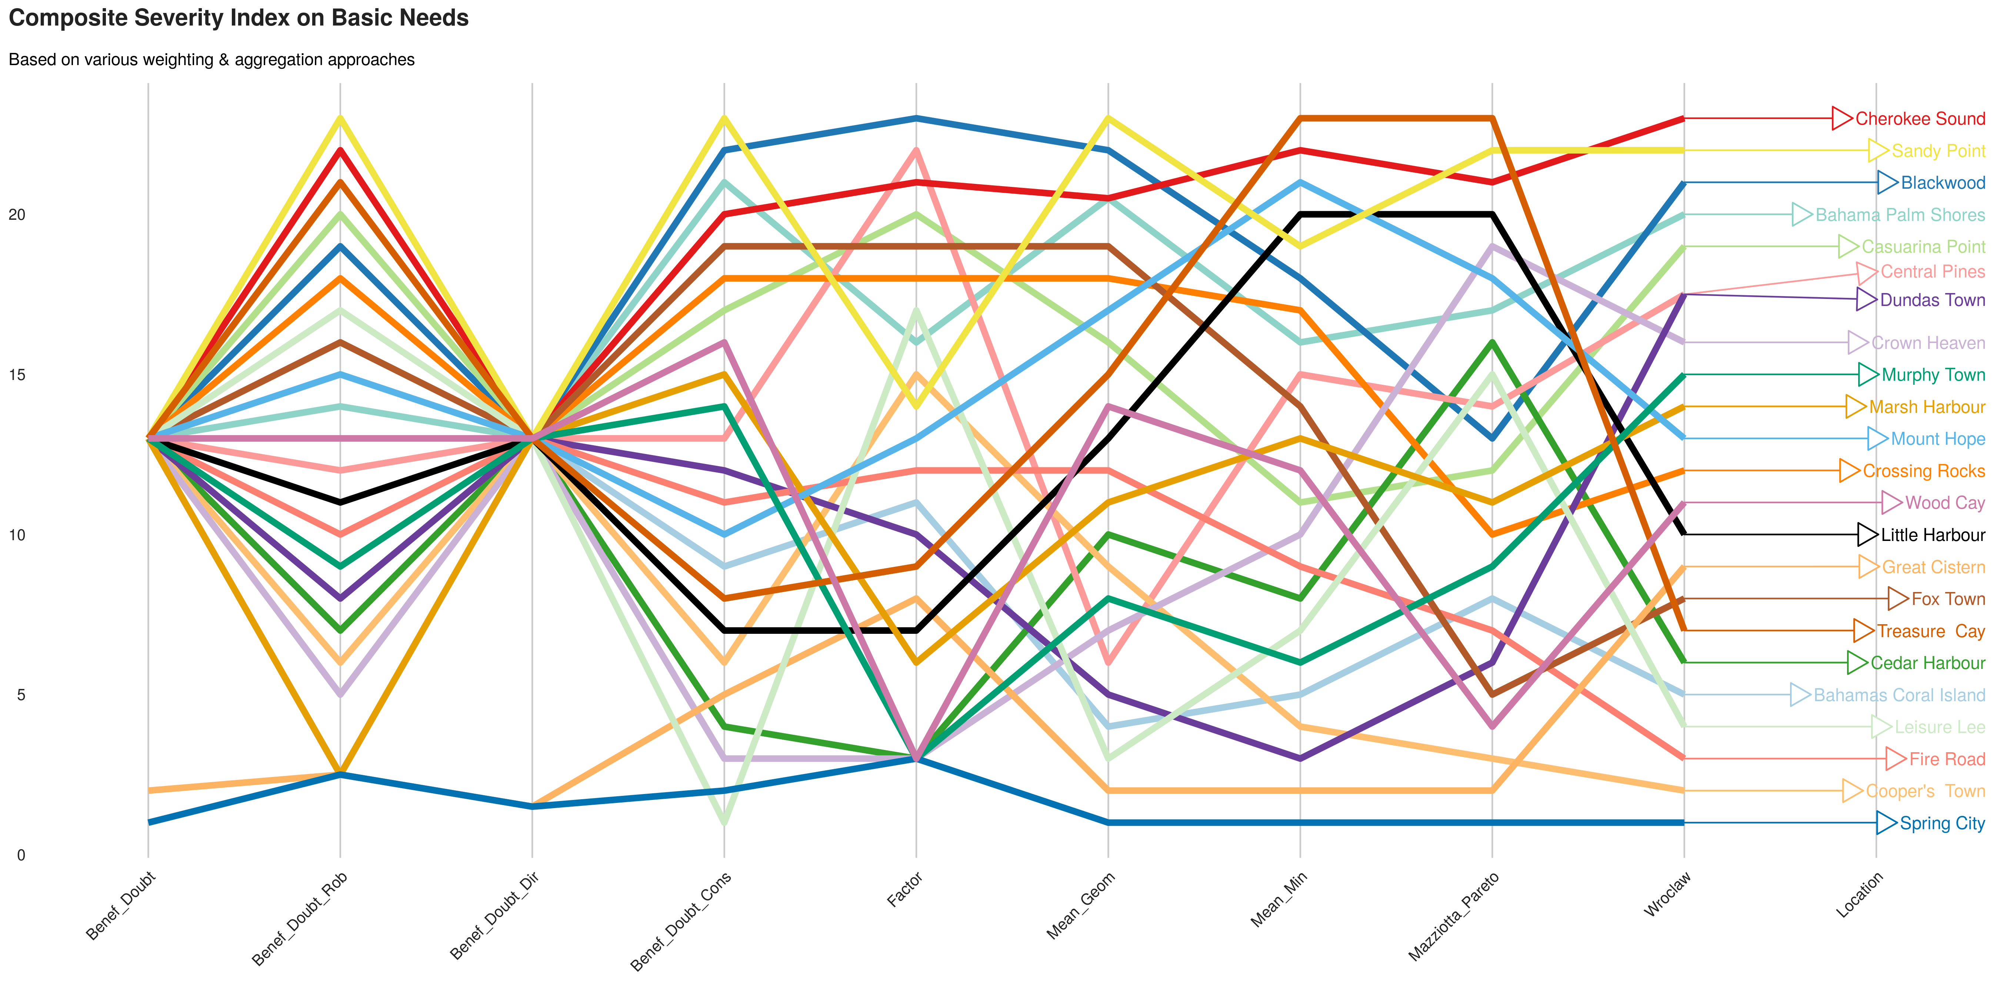
Comparing ranks per method

Slide 26
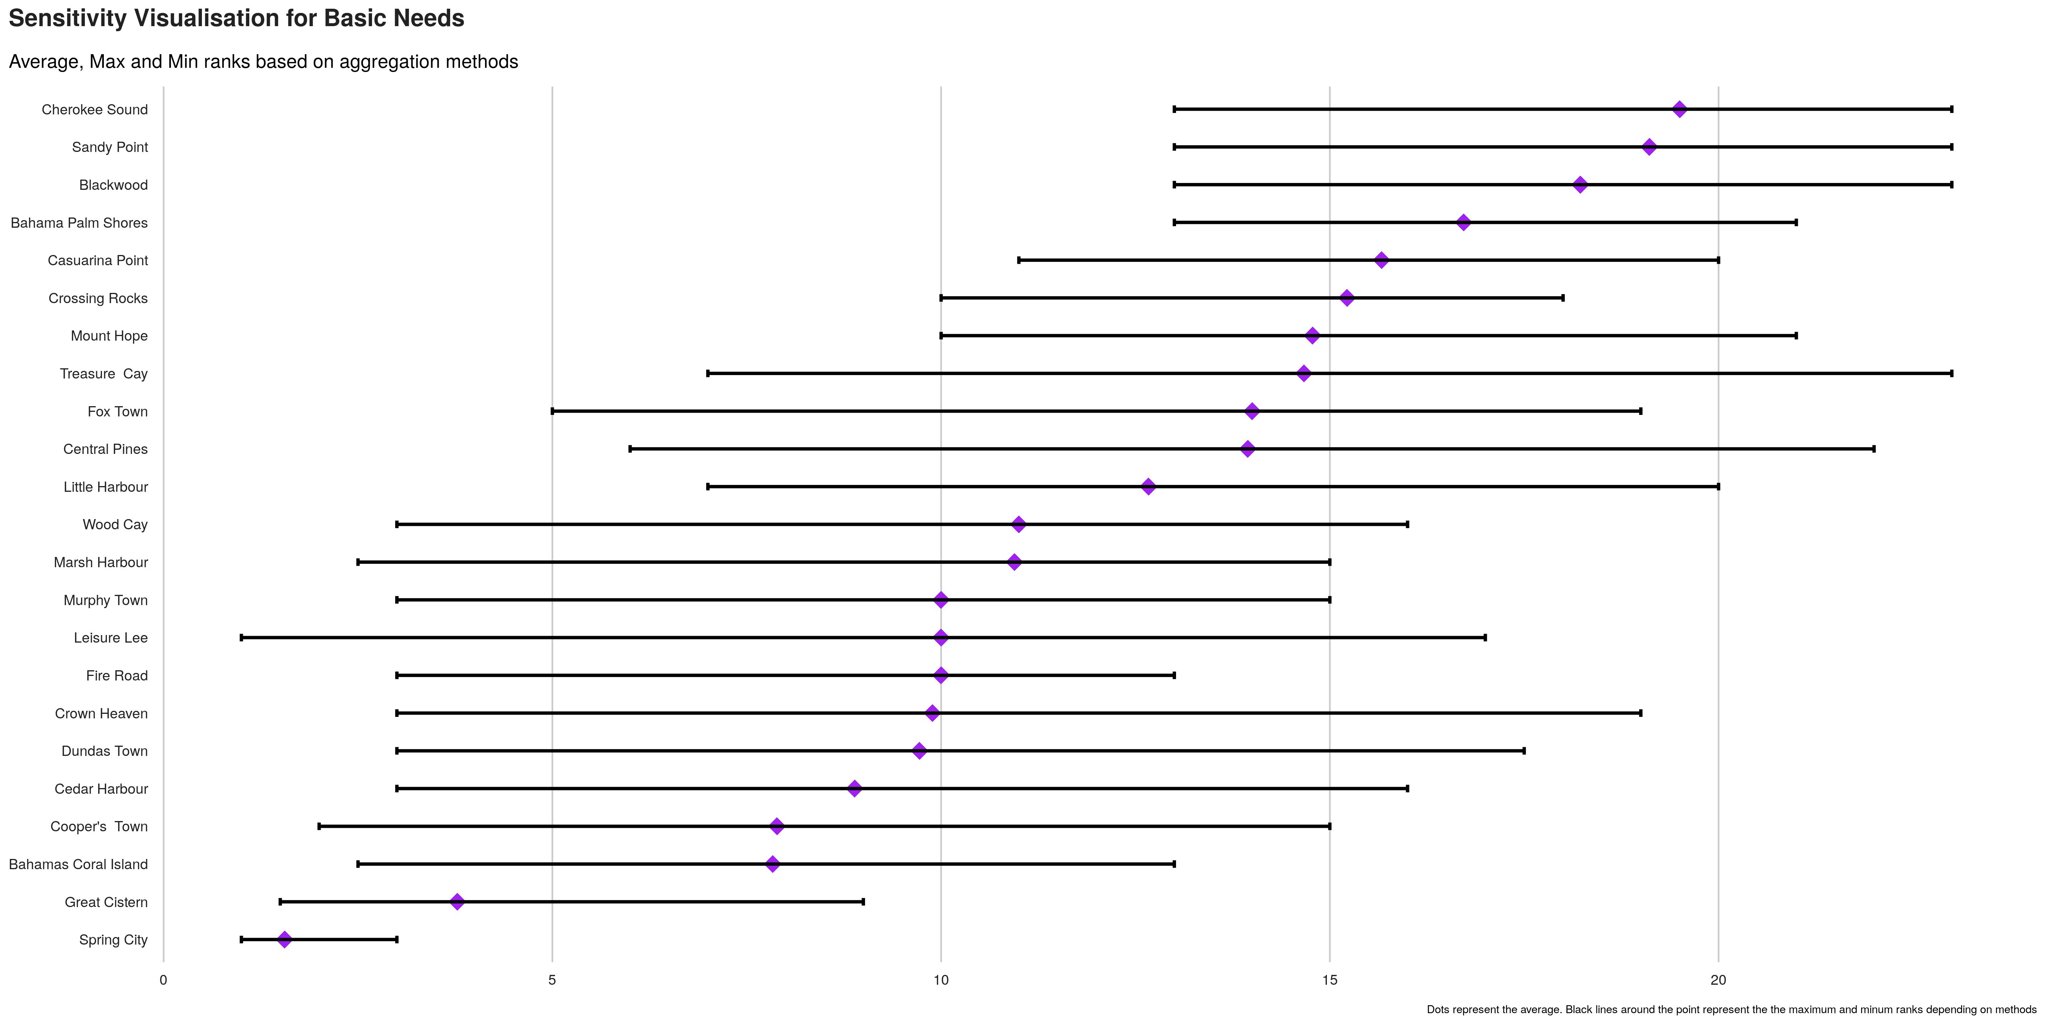
Index sensitivity to method

Slide 27
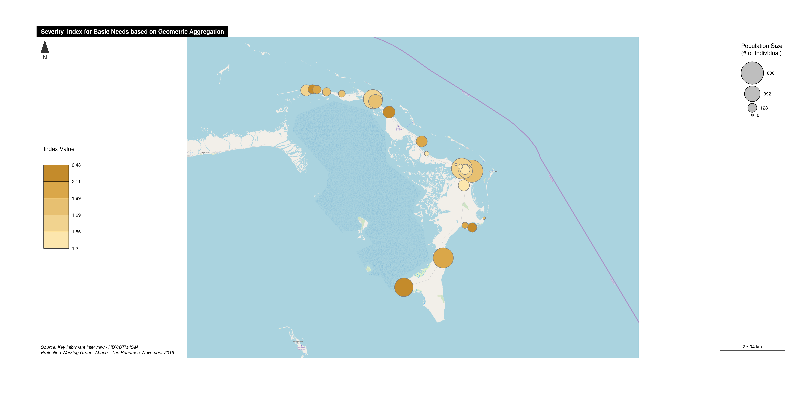
Severity Index Map

Slide 28

Smoothed Severity map

Slide 29
Thematic Dimension: WASH

Slide 30
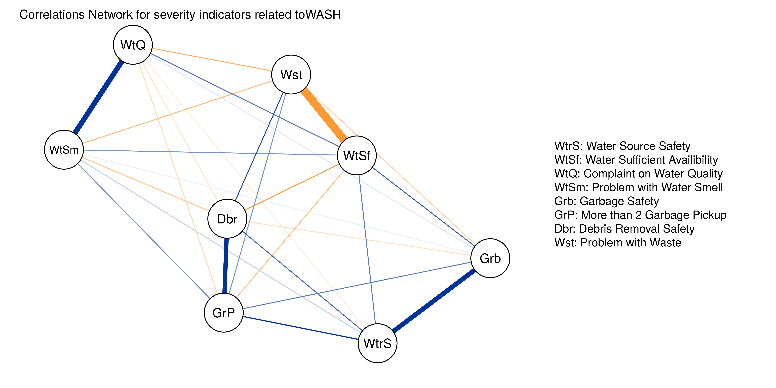
Correlations Network : (Alpha consistency is 0.6)

Slide 31
Selected Indicators
qlabel | Calculation | Polarity
Water Source Safety | scored | Positive (the higher score, the less severe)
Water Sufficient Availibility | binary | Positive (the higher score, the less severe)
Complaint on Water Quality | binary | Negative (the higher score, the more severe)
Problem with Water Smell | binary | Negative (the higher score, the more severe)
Garbage Safety | scored | Positive (the higher score, the less severe)
More than 2 Garbage Pickup | binary | Positive (the higher score, the less severe)
Debris Removal Safety | scored | Positive (the higher score, the less severe)
Problem with Waste | binary | Negative (the higher score, the more severe)

Slide 32
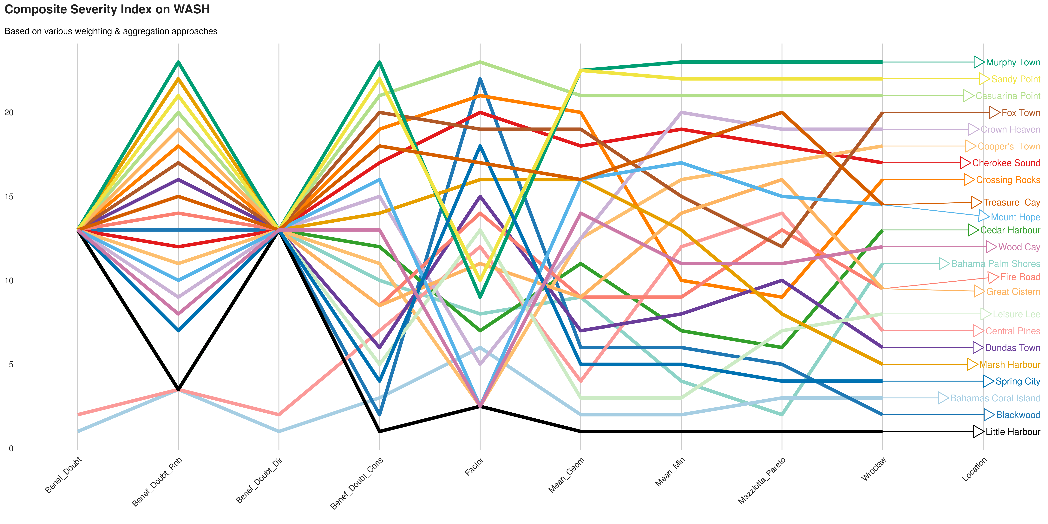
Comparing ranks per method

Slide 33
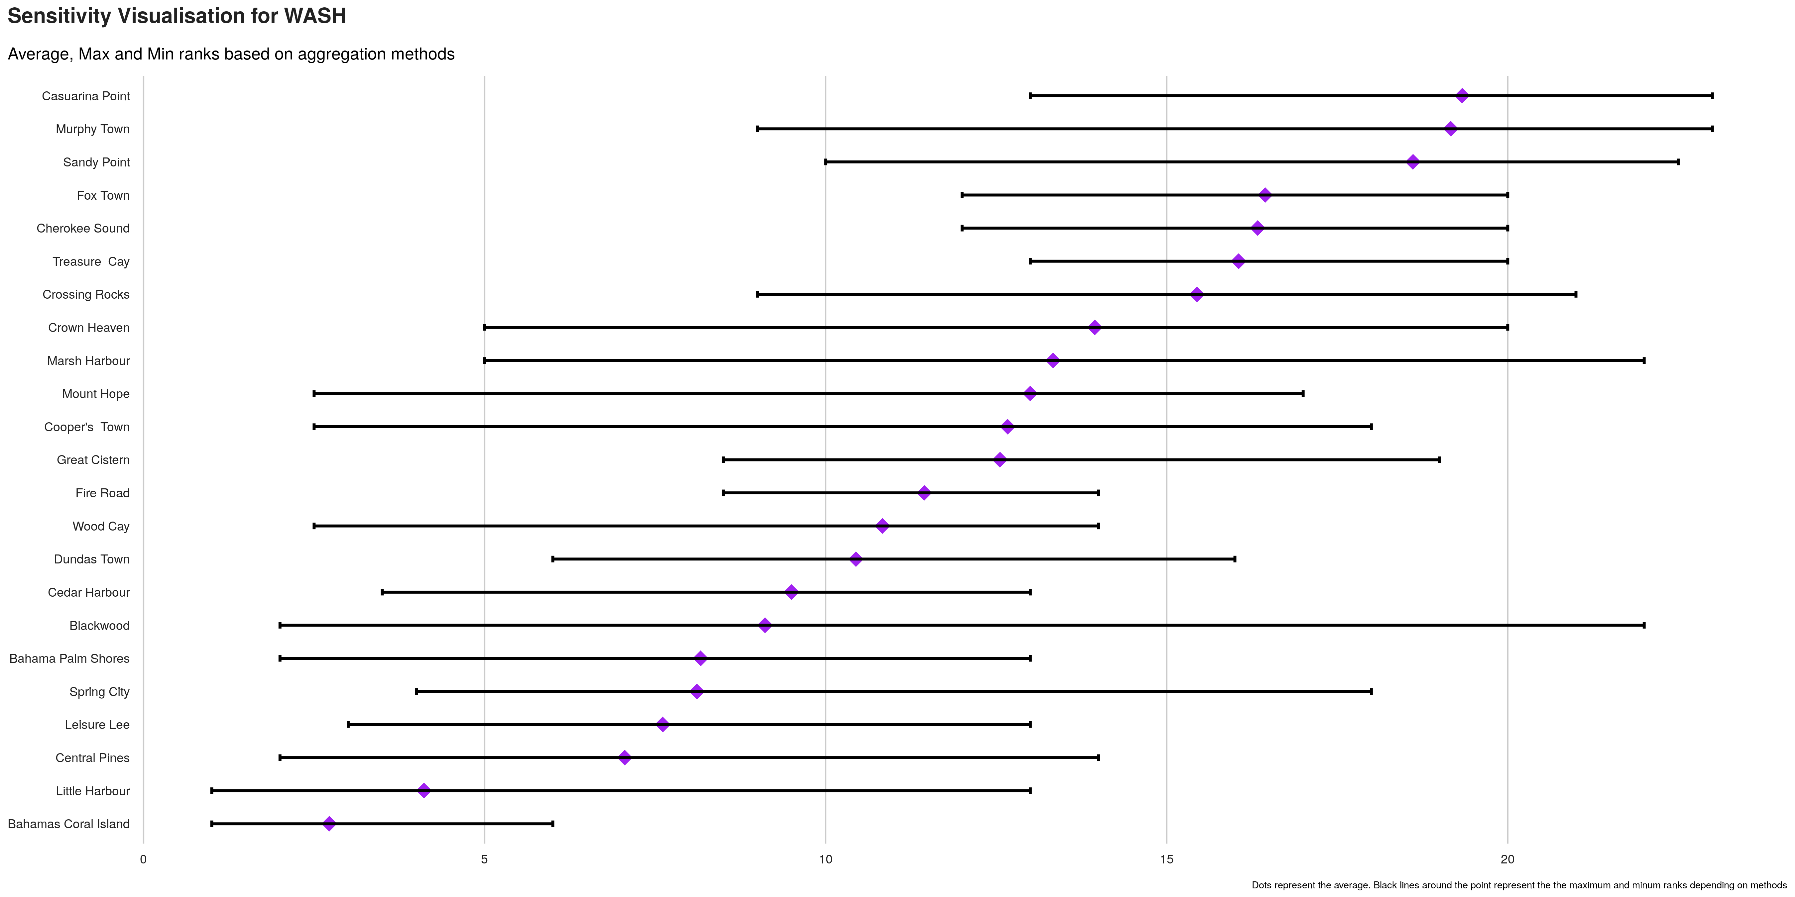
Index sensitivity to method

Slide 34
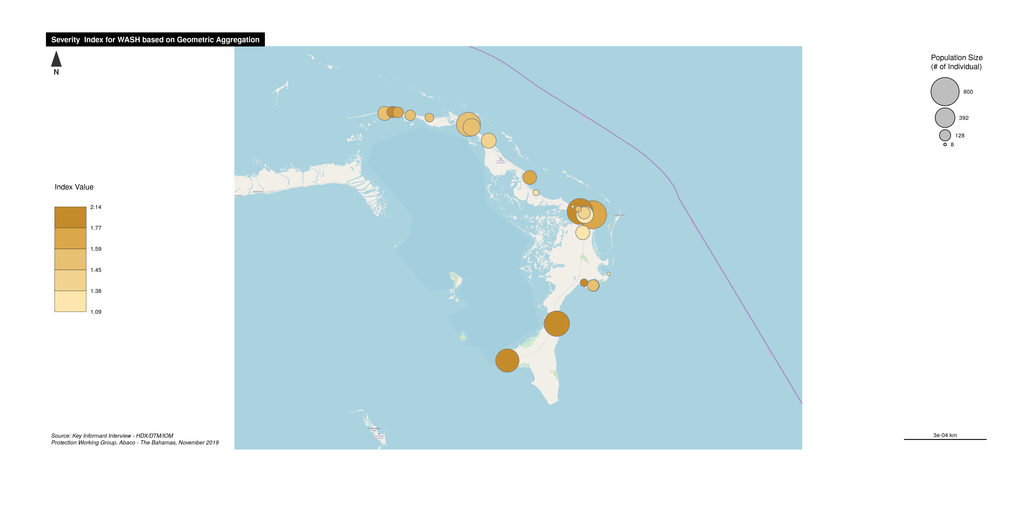
Severity Index Map

Slide 35
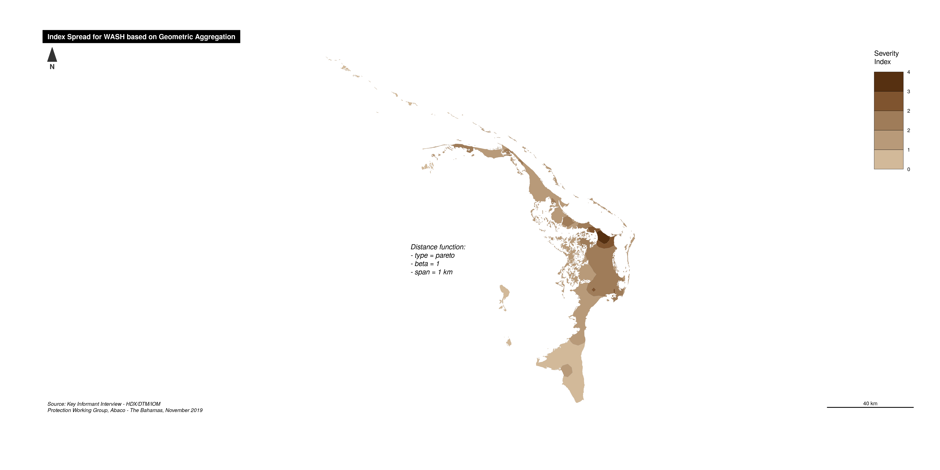
Smoothed Severity map

Slide 36
Thematic Dimension: Public Services

Slide 37
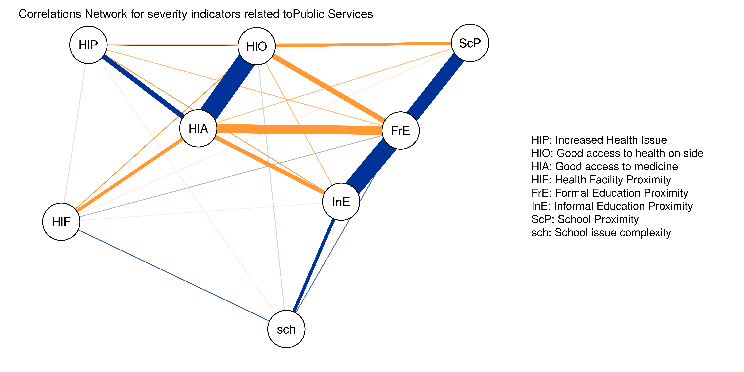
Correlations Network : (Alpha consistency is 0.78)

Slide 38
Selected Indicators
qlabel | Calculation | Polarity
Increased Health Issue | binary | Negative (the higher score, the more severe)
Good access to health on side | binary | Positive (the higher score, the less severe)
Good access to medicine | binary | Positive (the higher score, the less severe)
Health Facility Proximity | scored | Negative (the higher score, the more severe)
Formal Education Proximity | scored | Negative (the higher score, the more severe)
Informal Education Proximity | scored | Negative (the higher score, the more severe)
School Proximity | scored | Negative (the higher score, the more severe)
School issue complexity | scored | Negative (the higher score, the more severe)

Slide 39
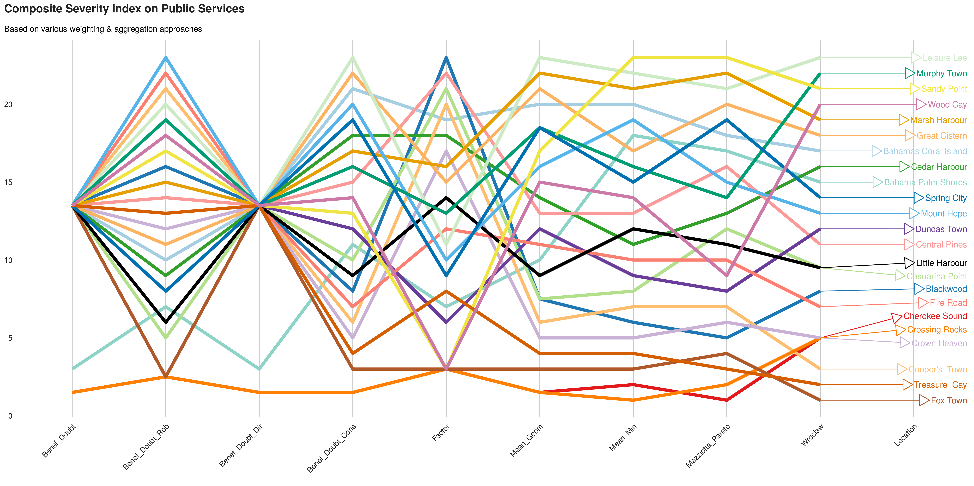
Comparing ranks per method

Slide 40
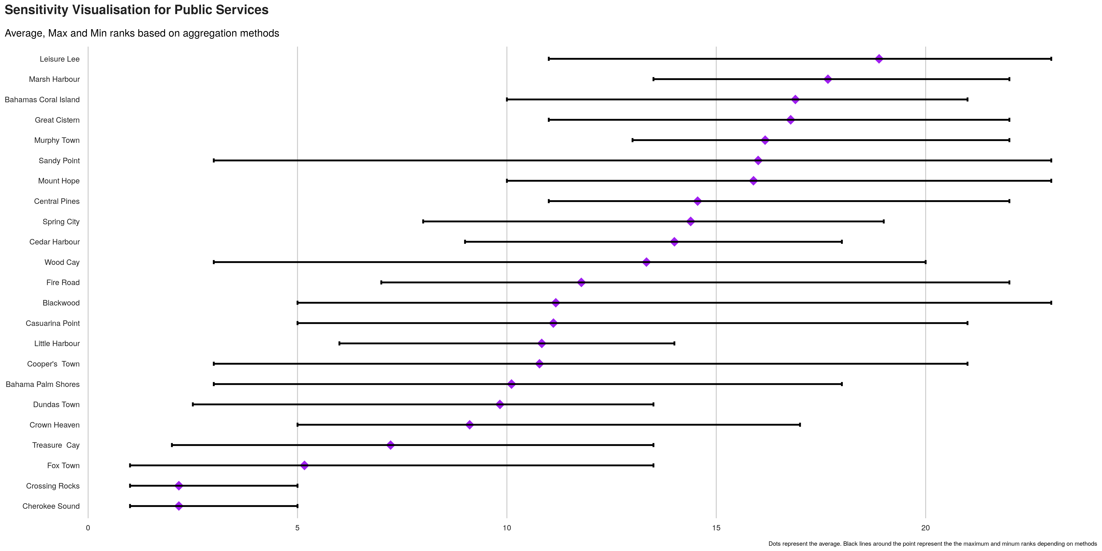
Index sensitivity to method

Slide 41
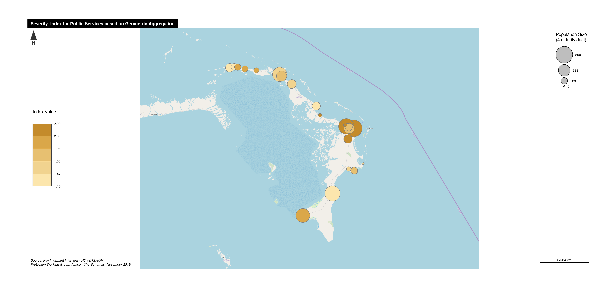
Severity Index Map

Slide 42
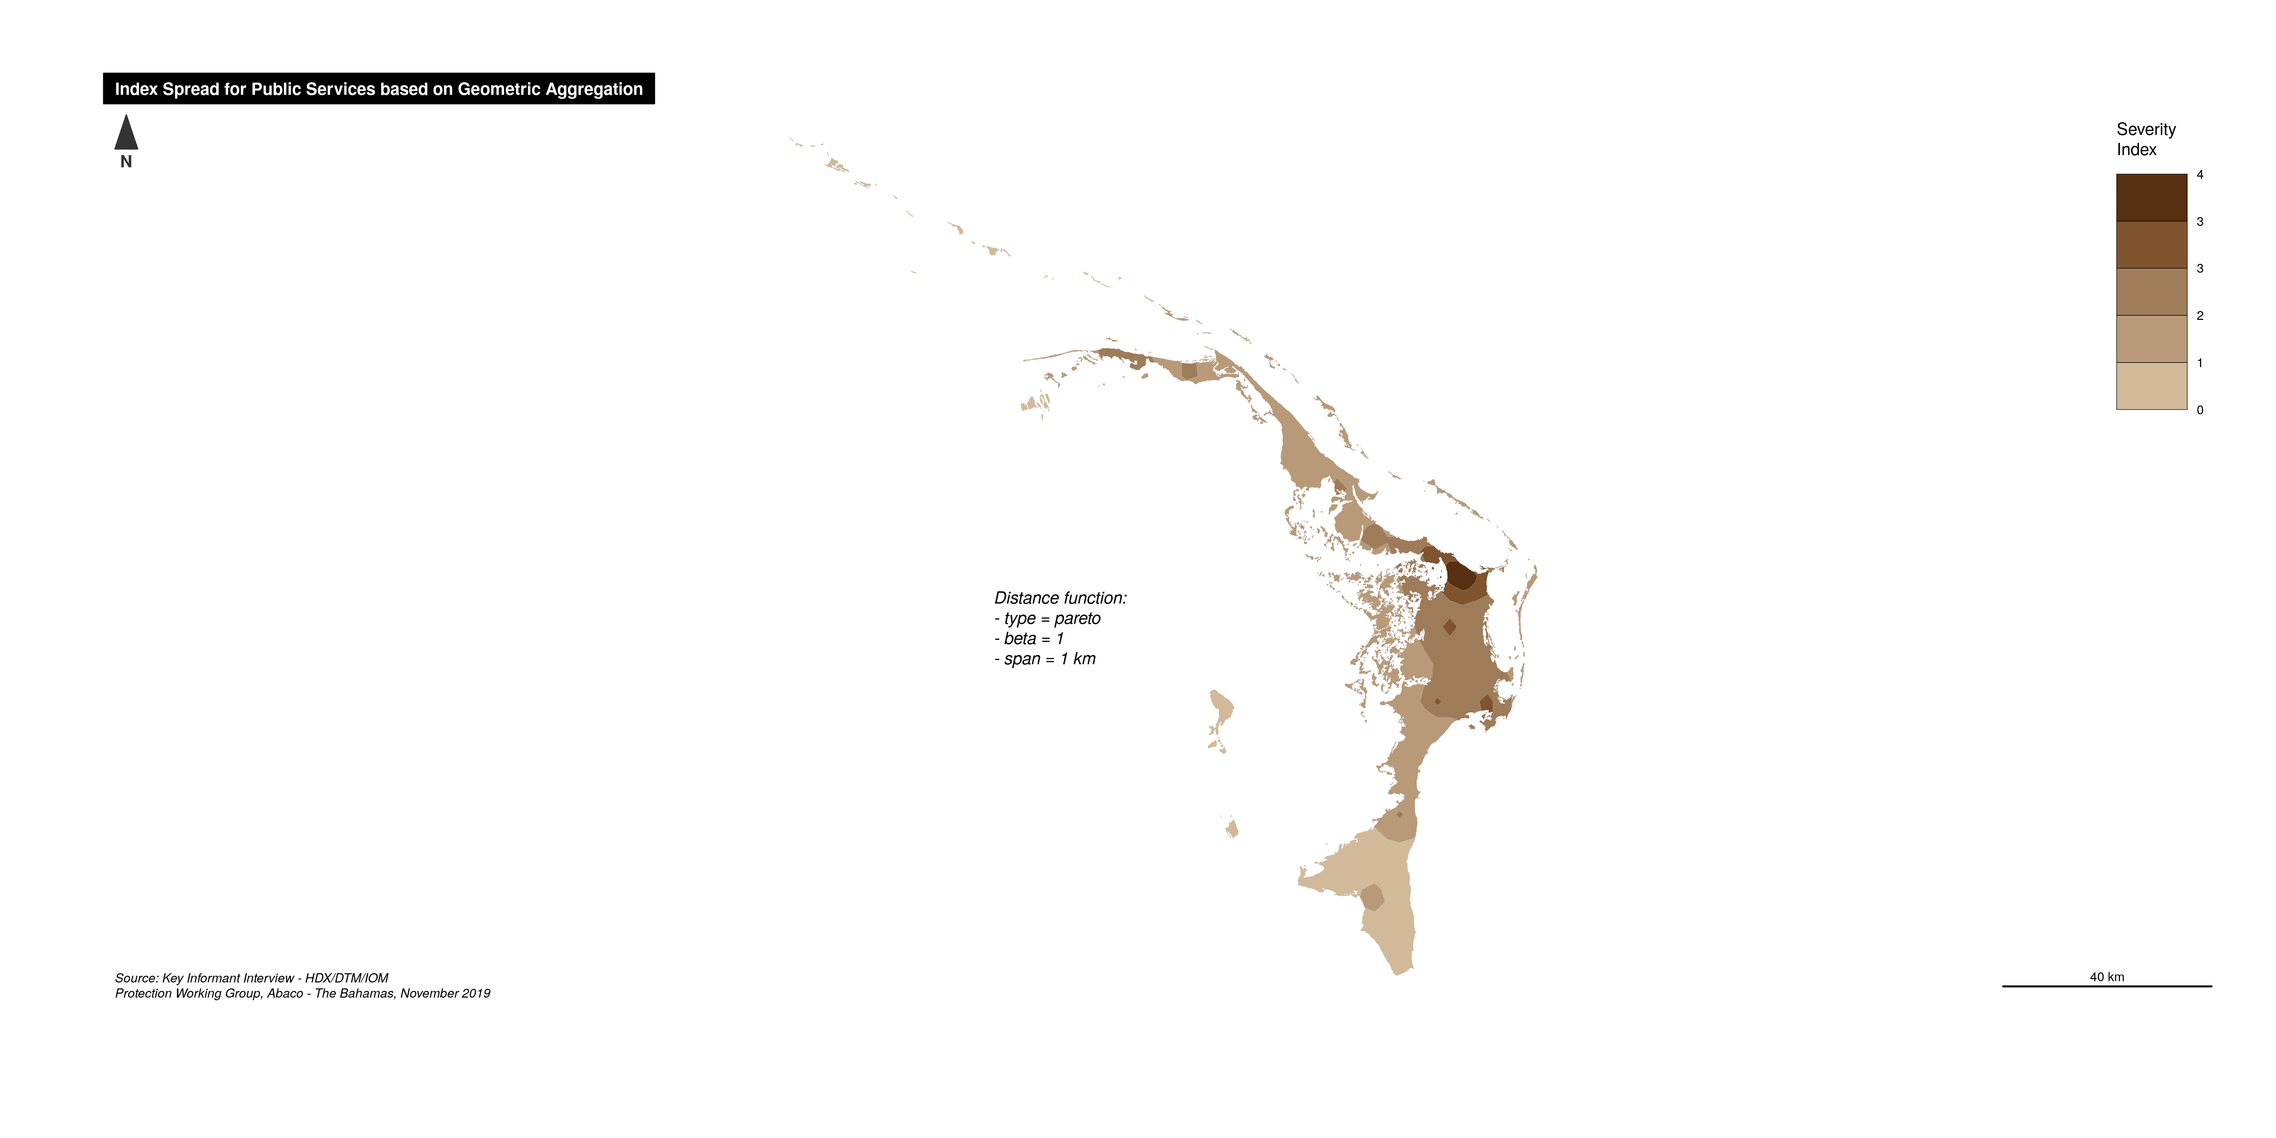
Smoothed Severity map

Slide 43
Thematic Dimension: Social Safety Net

Slide 44
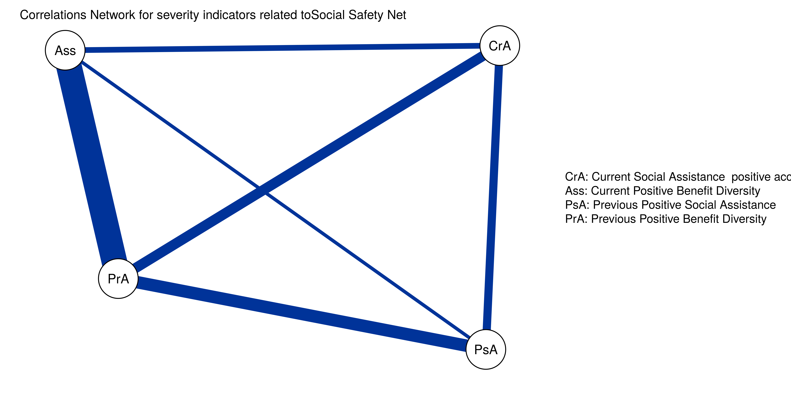
Correlations Network : (Alpha consistency is 0.85)

Slide 45
Selected Indicators
qlabel | Calculation | Polarity
Current Social Assistance positive access | binary | Positive (the higher score, the less severe)
Current Positive Benefit Diversity | scored | Positive (the higher score, the less severe)
Previous Positive Social Assistance | binary | Positive (the higher score, the less severe)
Previous Positive Benefit Diversity | scored | Positive (the higher score, the less severe)

Slide 46
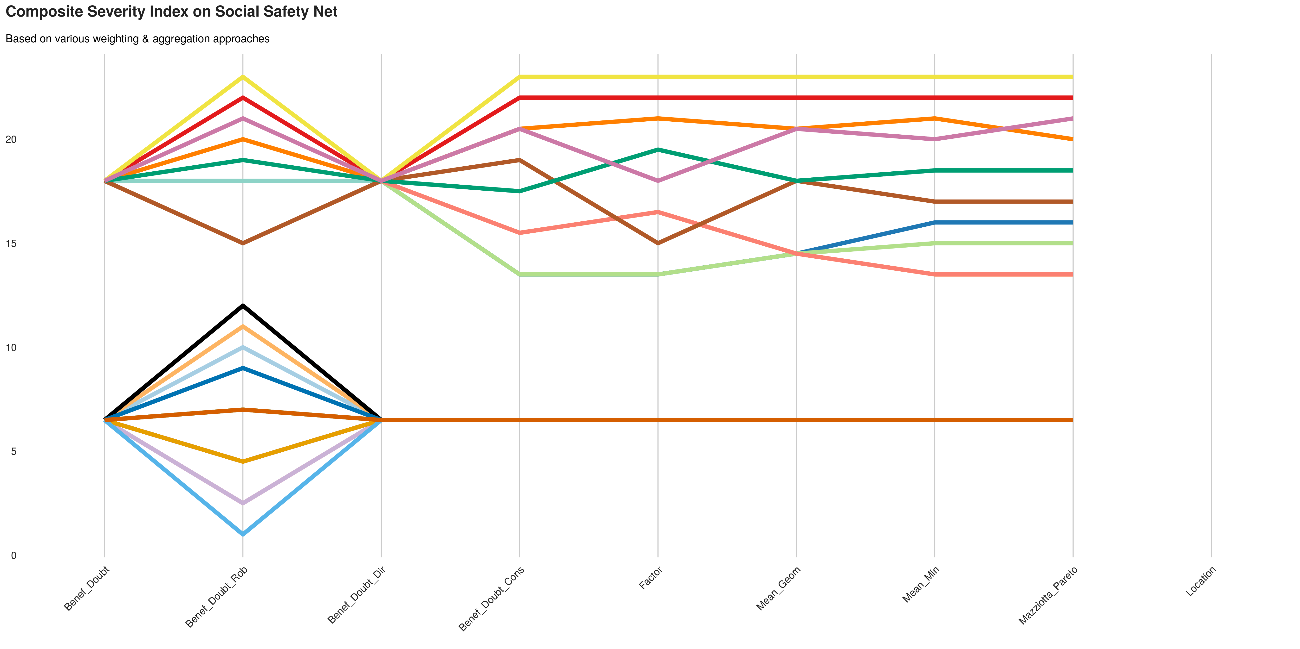
Comparing ranks per method

Slide 47
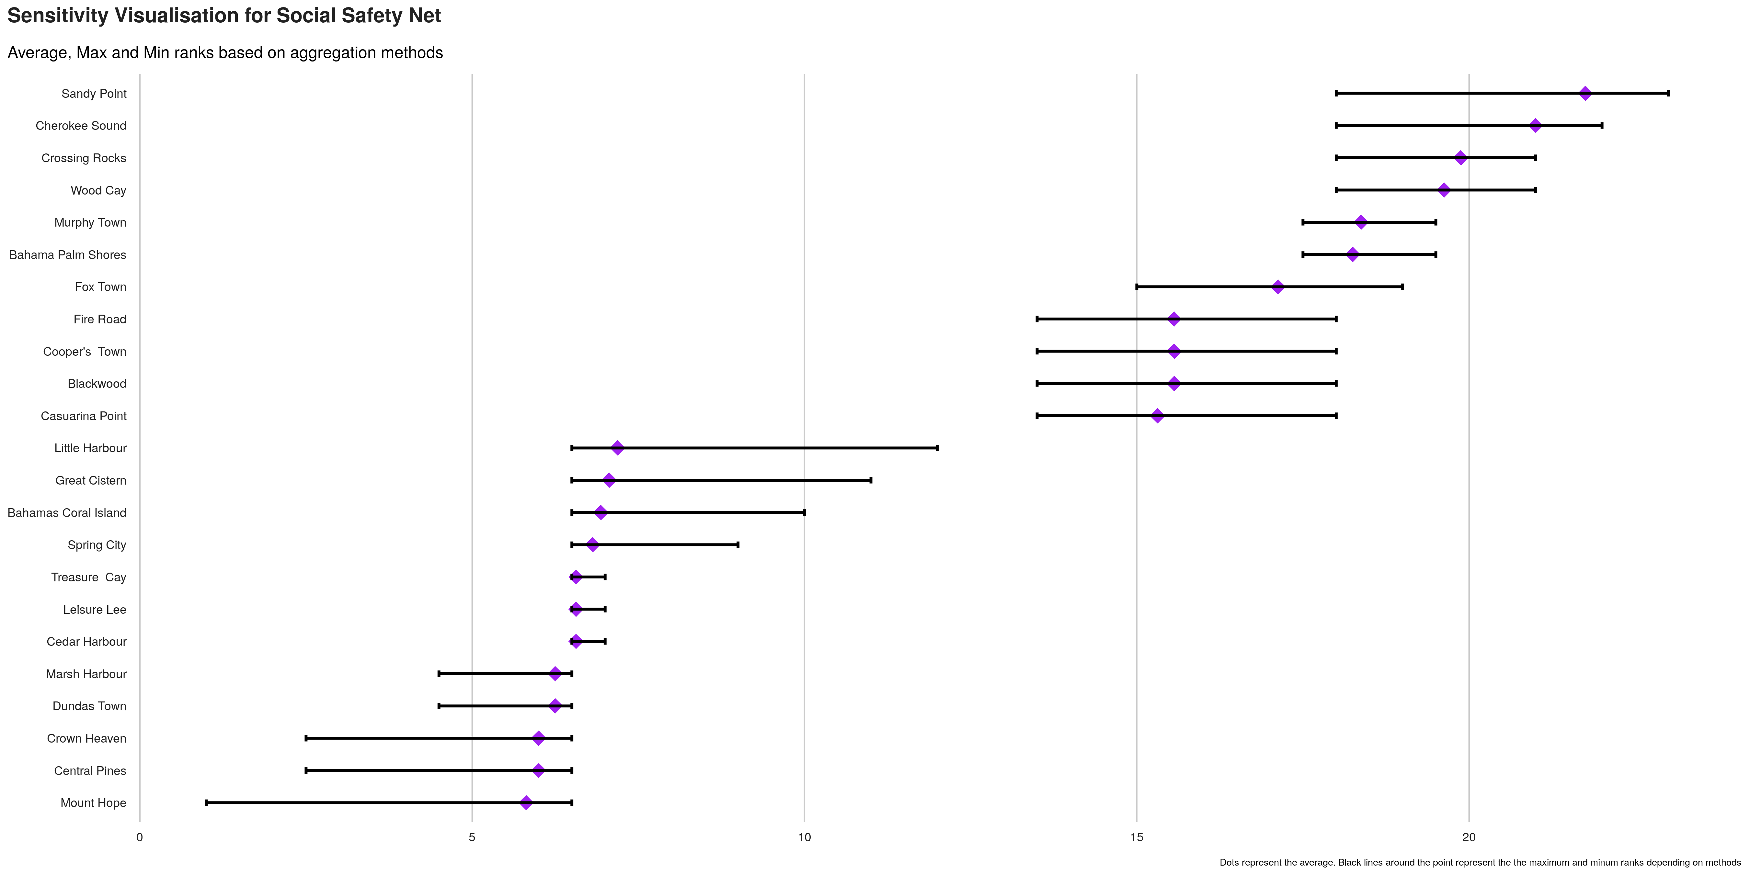
Index sensitivity to method

Slide 48
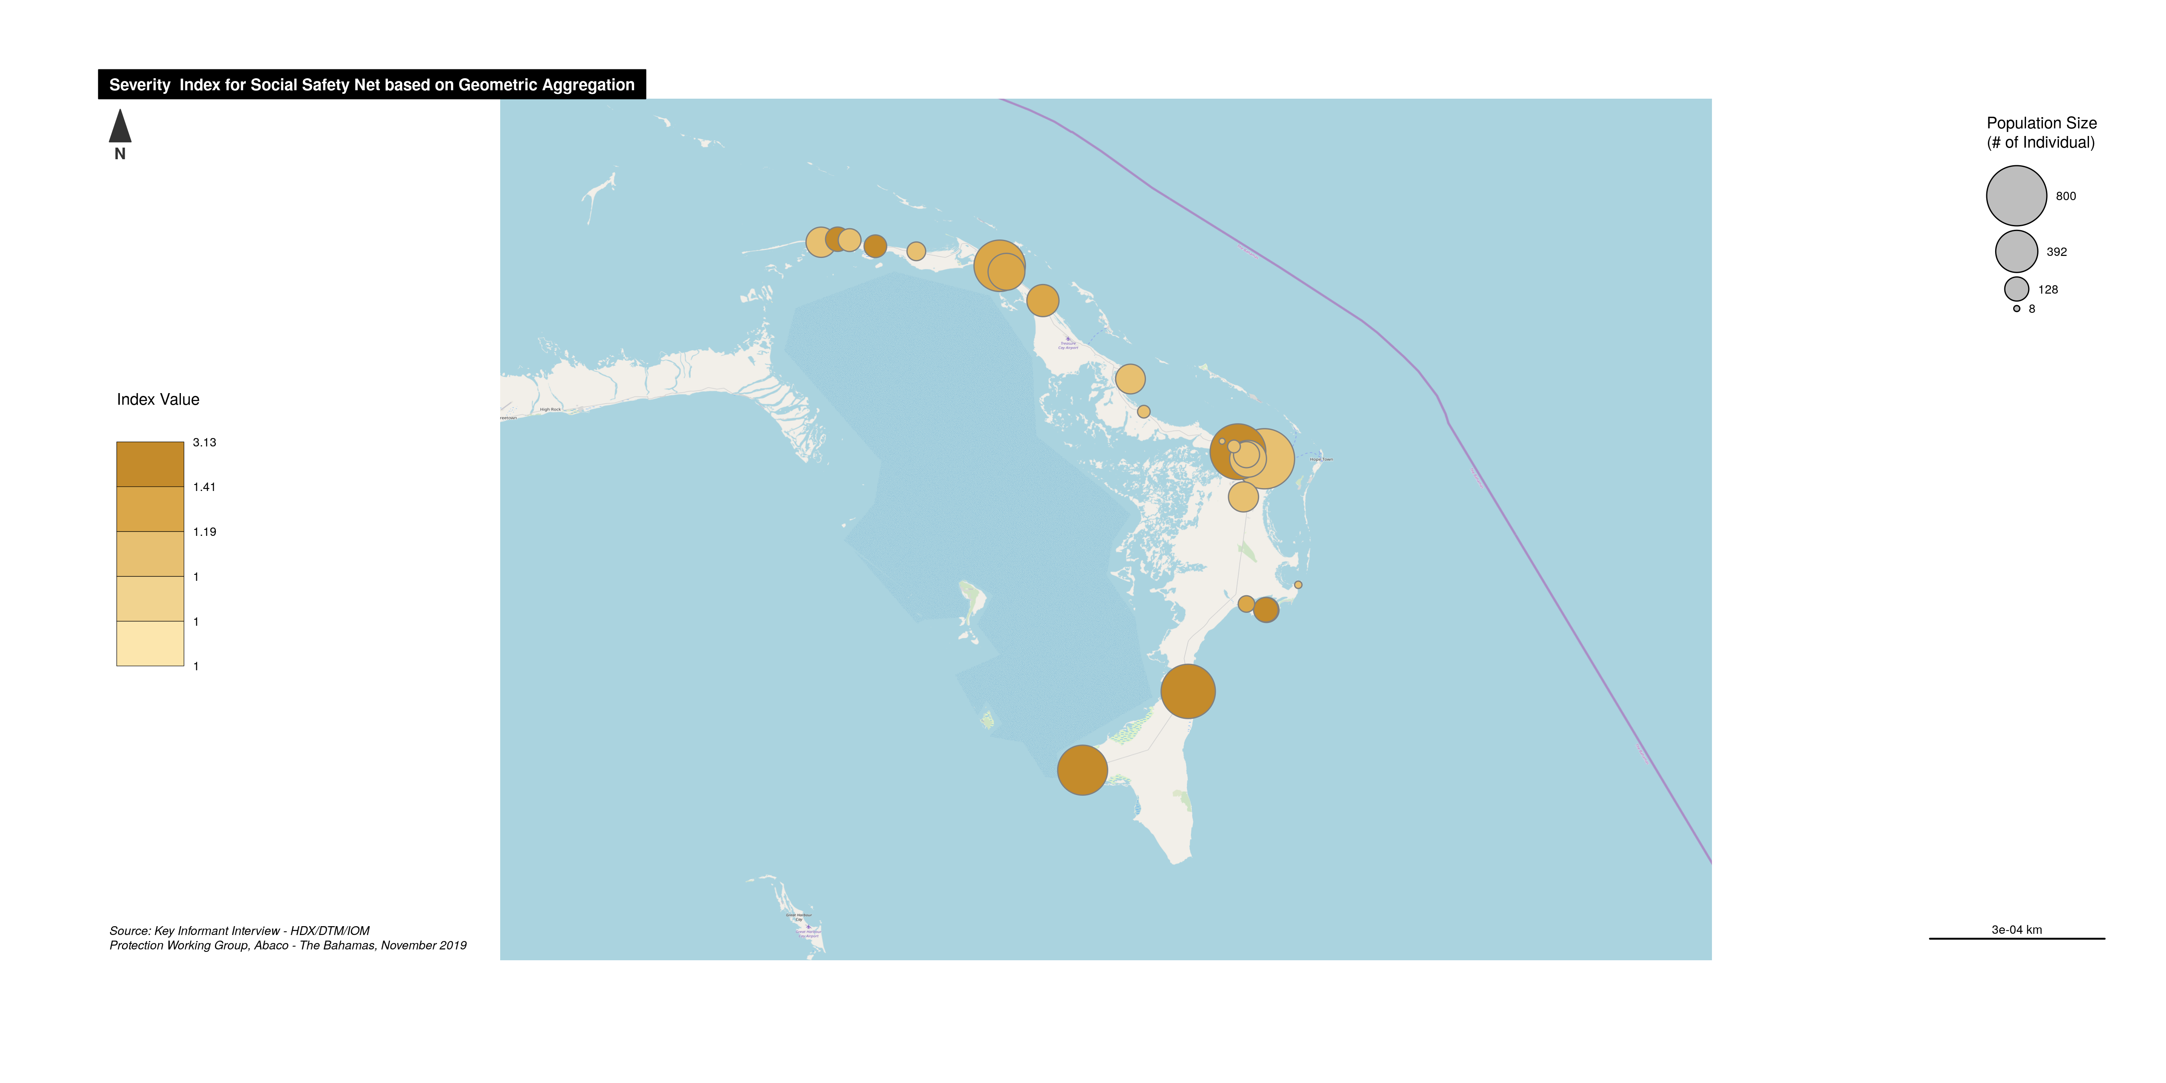
Severity Index Map

Slide 49

Smoothed Severity map

Slide 50
Full Composite on Severity: aggregating all themes

Slide 51
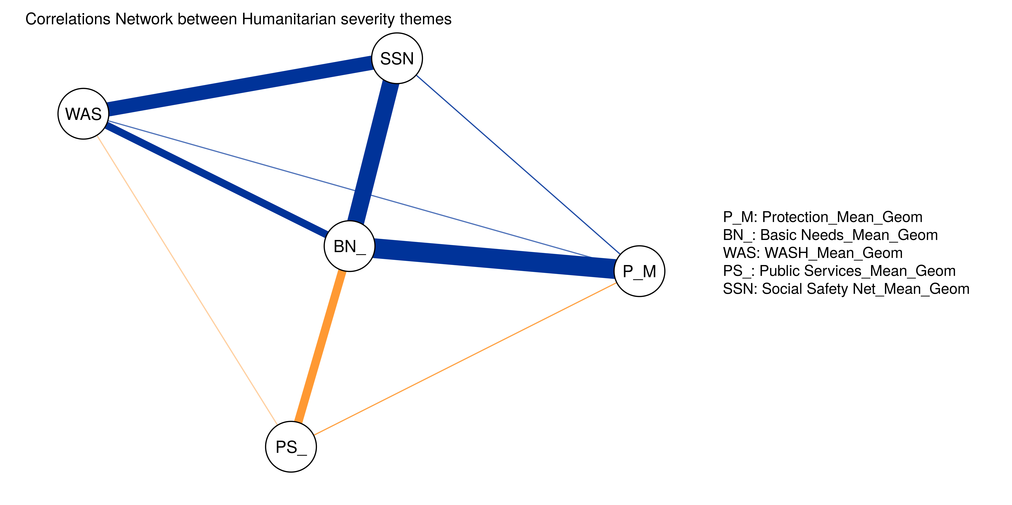
Correlations Network : (Alpha consistency is 0.79)

Slide 52
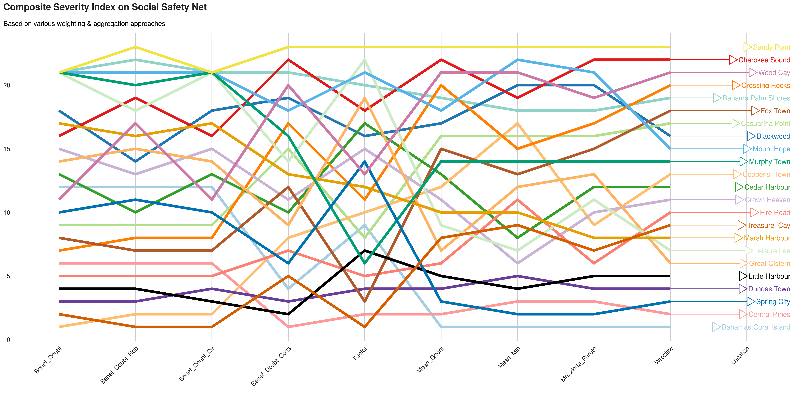
Comparing ranks per method

Slide 53
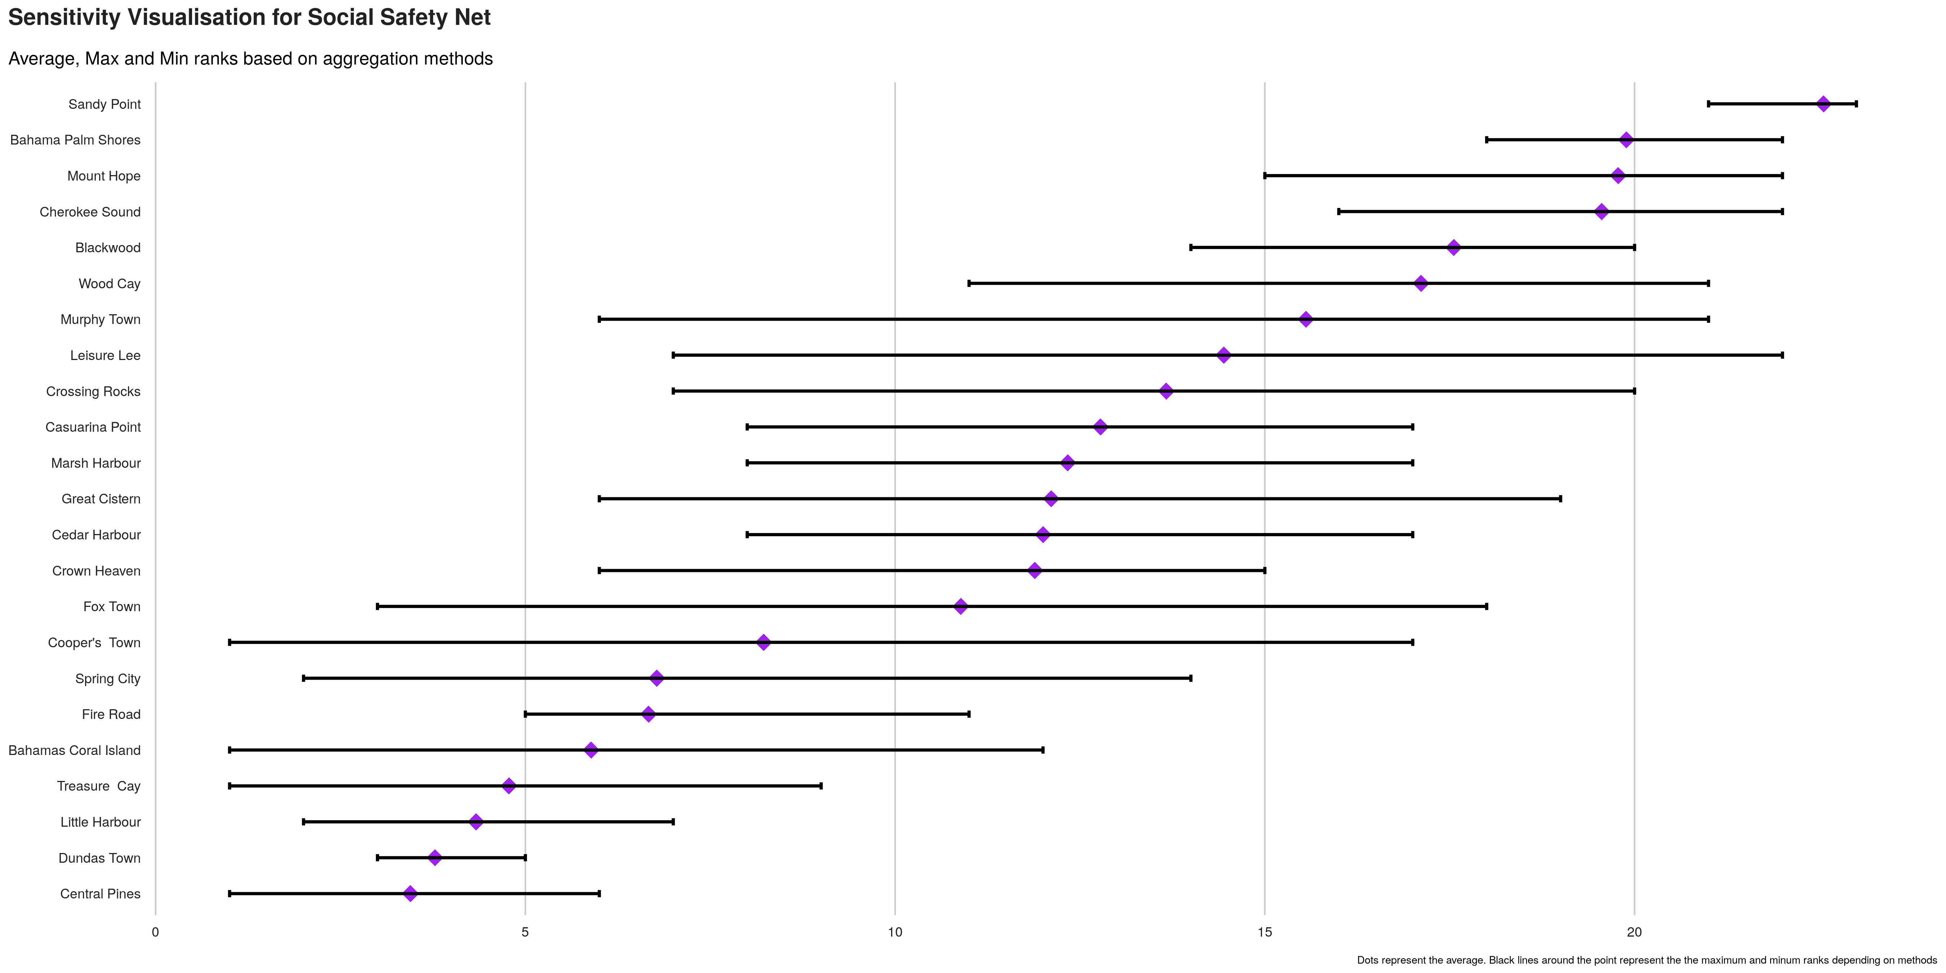
Index sensitivity to method

Slide 54
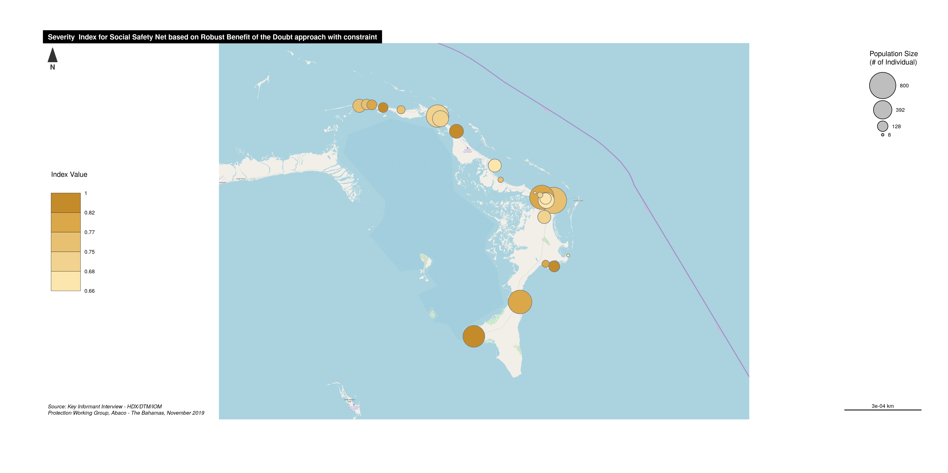
Severity Index Map

Slide 55
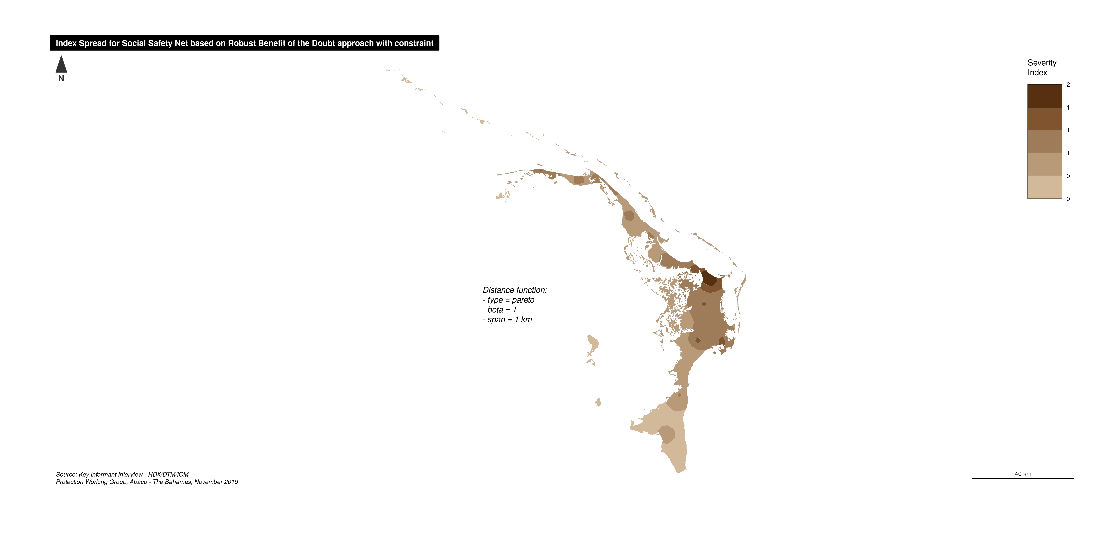
Smoothed Severity map

